Slide 1
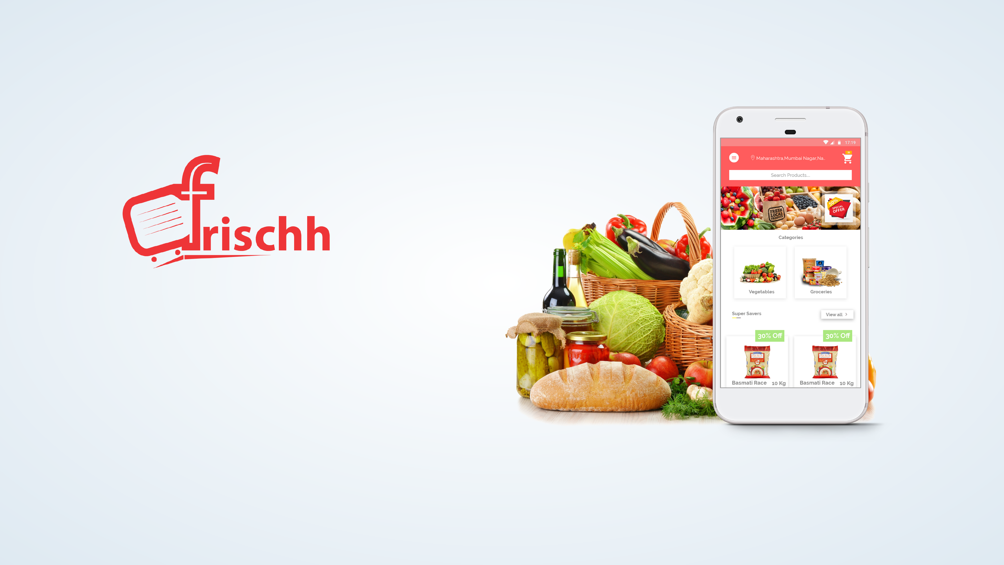
Frischh Parnerships
Uplifting Grocery to Subscription Economy

Slide 2

The Reality
Offline grocery stores are lacking technology to enter e-commerce.
A big slice of revenue is lost due to poor marketing technology.
Customer engagement has never been a priority in a sensible way.

Slide 3

A Transformation
Meet Frischh Partnerships, An intelligent platform that brings you an incredibly growing consumer base every month through
subscriptions.
Boost your monthly sales with shooting trajectory of sustainable monthly recurring revenue from your loyal customer base of
subscribers.
Delight your customers by broadcasting in-store promotions
through seamless mobile experience.
Sitback and watch the platform managing deliveries automatically and enrich your bank account with consistent inflow of subscription revenue.

Slide 4
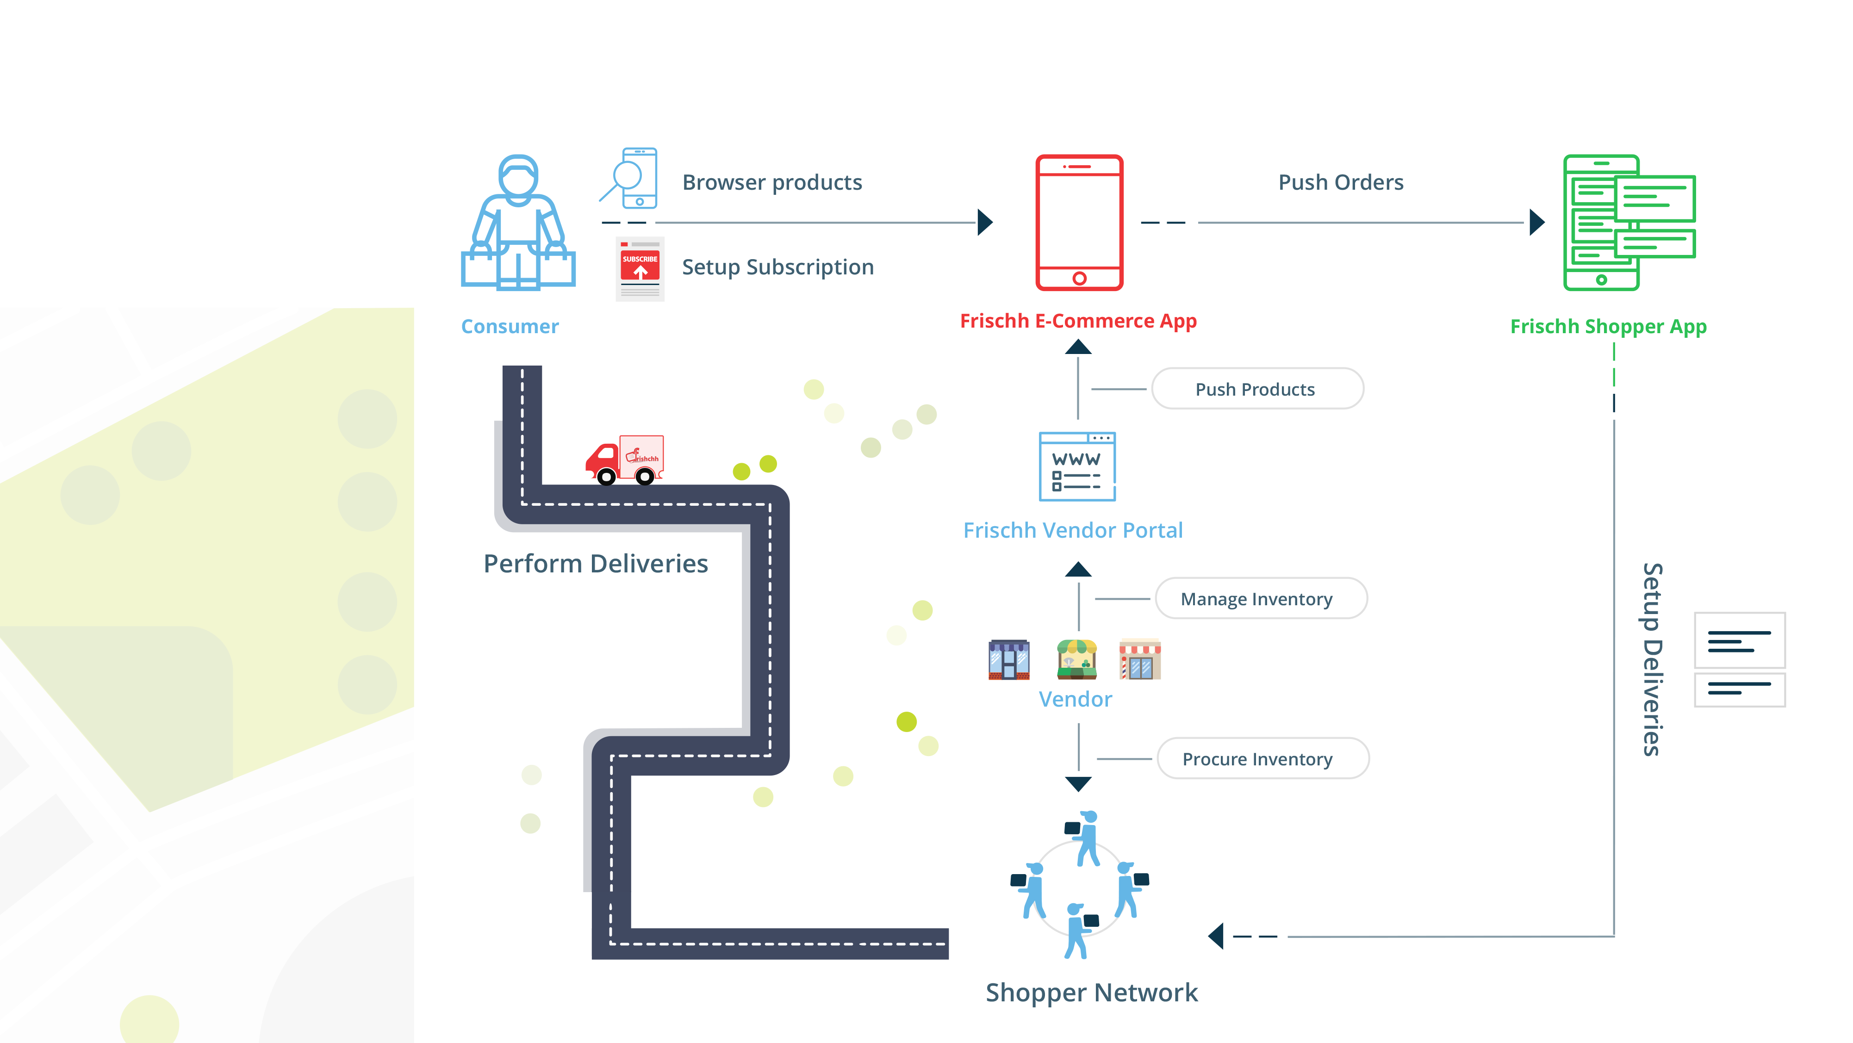
How Friscch Works

Slide 5
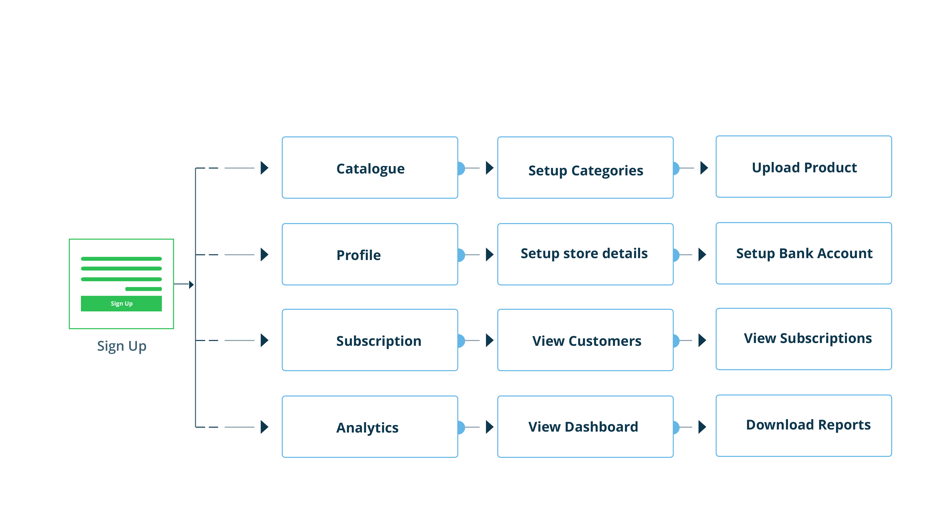
Key Features

Slide 6
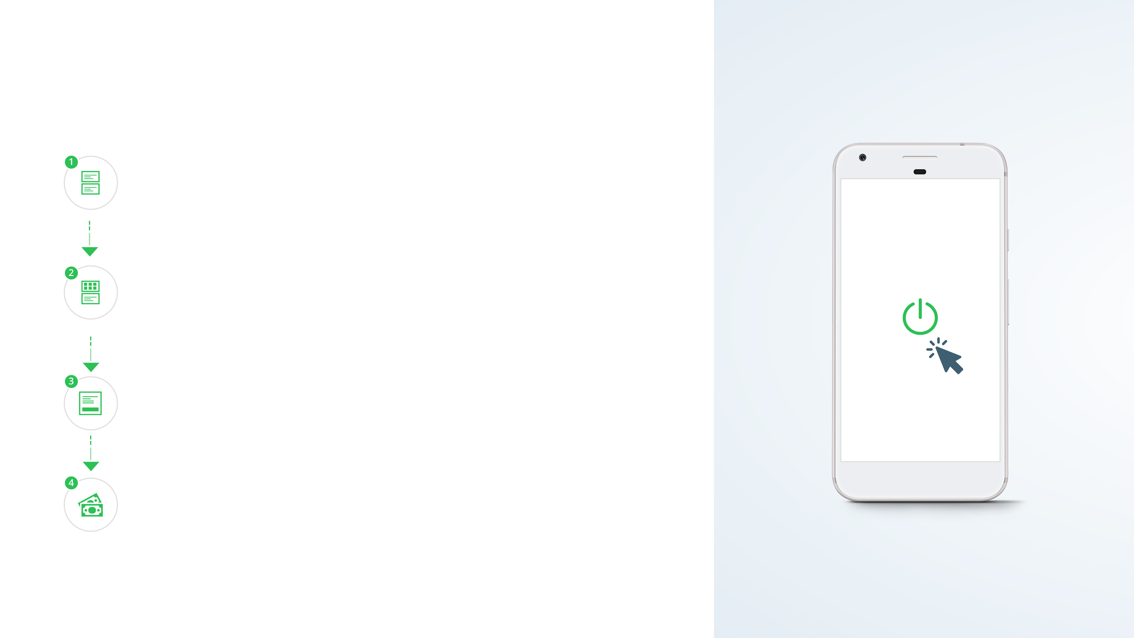
How to get started
Onboard
Signup to Frischh Partnership www.frischh.com/partners and one of our sales representative will be in touch.
Setup Shop
You can build your own personalised catalogue by setting up categories, products and their specifications.
Setup Bank
You need to setup the beneficiary bank account for getting paid for all your subscriptions.
Get Paid
Enjoy your subscription payments every month for your net
MRR for entire consumer base.

Slide 7
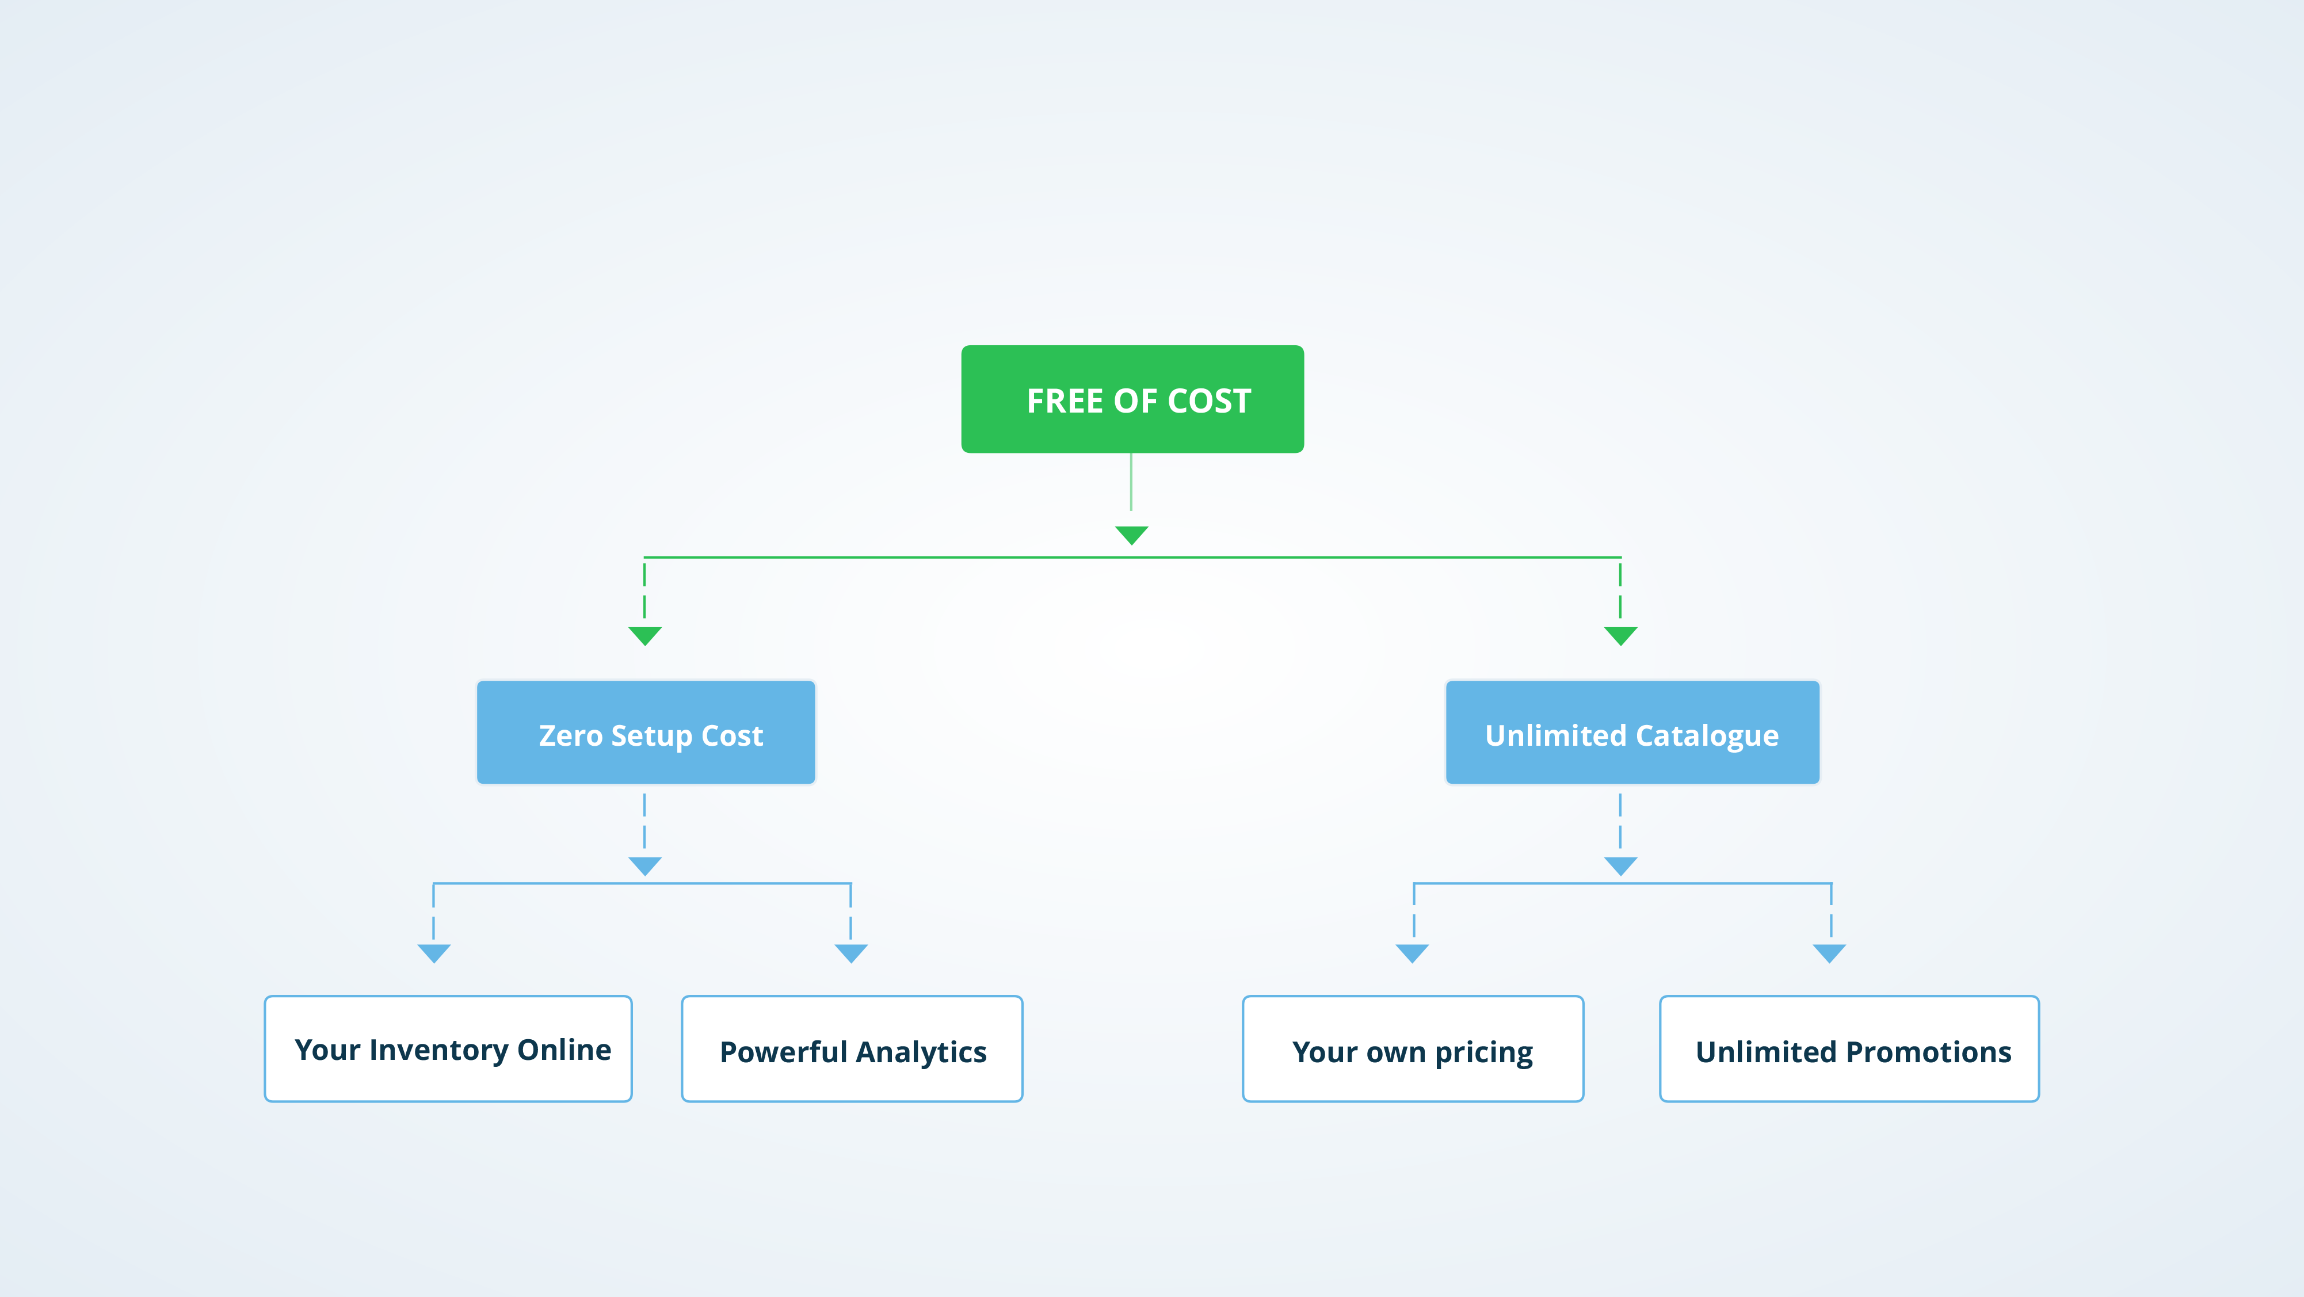
Core Value Propositions

Slide 8
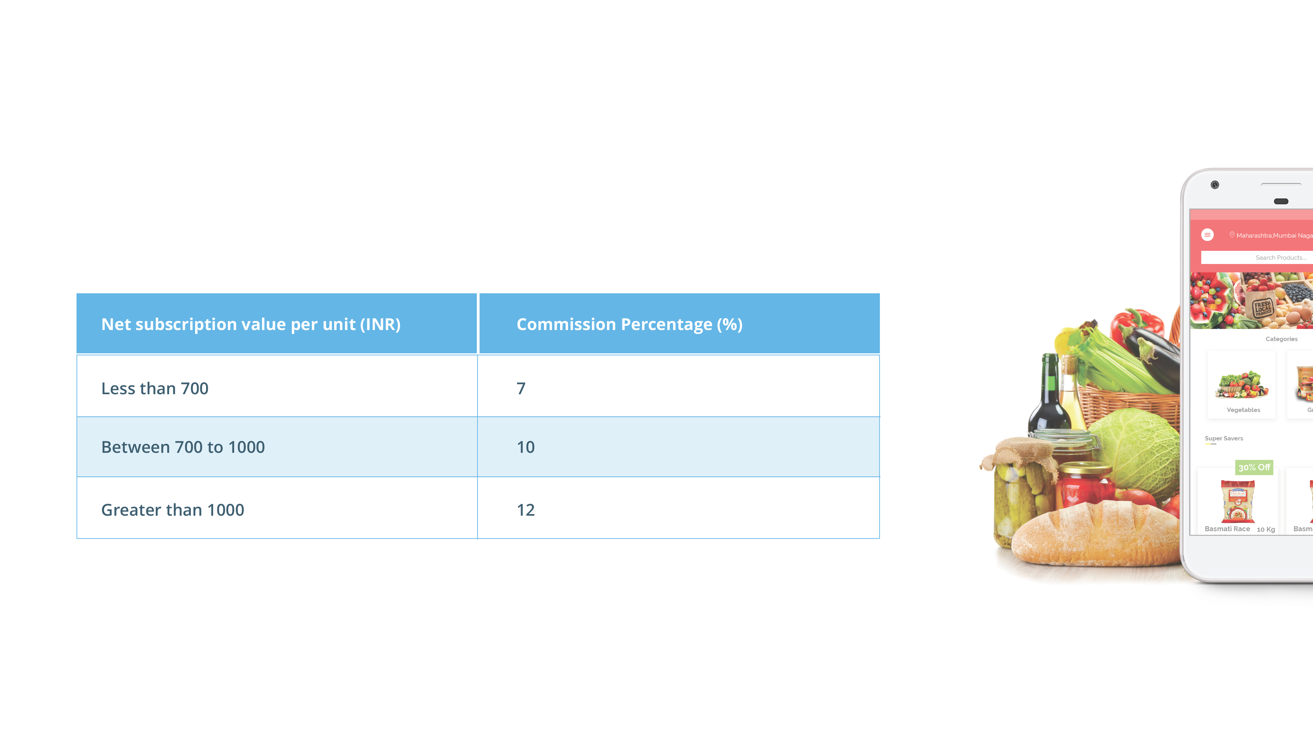
Cost Structure
Frischh uses Hyper Local revenue share business model powered by logistics of shopper network.

Slide 9

Contact Us
For any queries and inquiry, please send us a note at
support@frischh.com

